Slide 1
Viability of Restaurants and Locations
In the Greater Melbourne Metro Region

Slide 2
Background
Metro Melbourne is made up of numerous cities
  Cities are further broken down into suburbs
Melbourne is culturally diverse
  Resulting in cuisine diversity

Slide 3
Data Acquisition
City/Suburb names (via Wikipedia)
Age/Income statistics (via Australian Bureau of Statistics)
Existing Restaurants per Area (via FourSquare)

Slide 4
Noteworthy Trends
Cities on the outskirts of the metropolitan area:
  Tend to have the highest average disposable income
  Have a much lower population density
Cities closer to the city center:
  Have a lower, but still significant disposable income
  Much higher population density
    Much higher number of potential customers

Slide 5
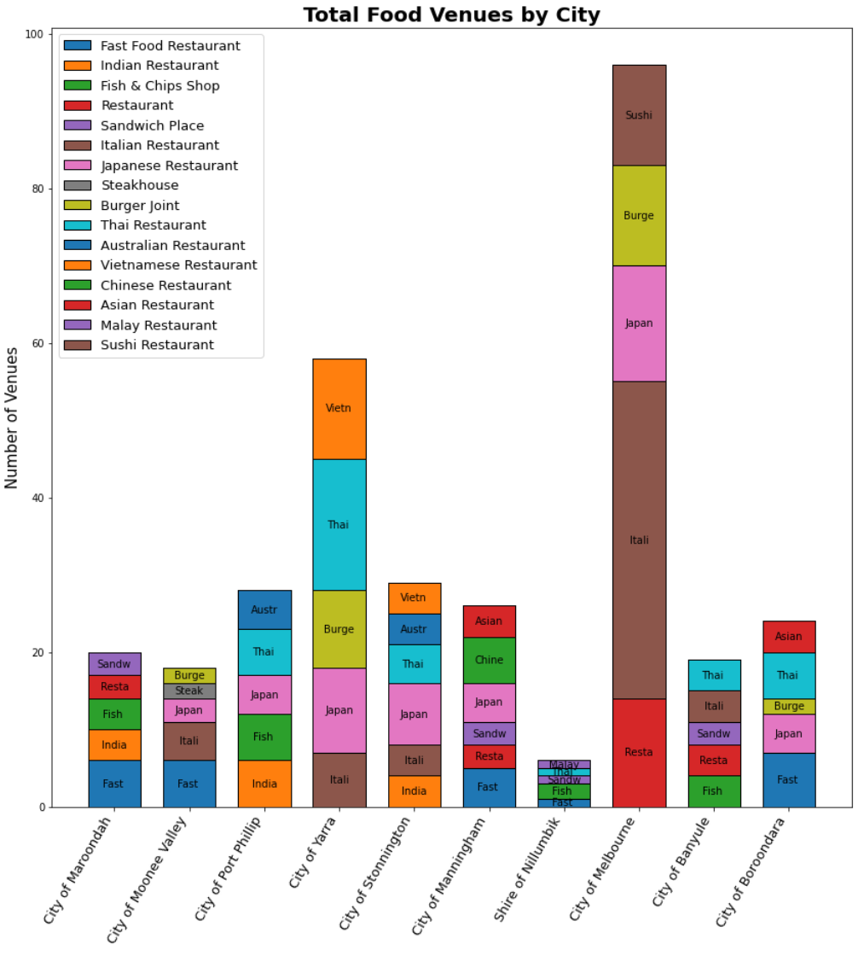
Cuisine Preferences
Cuisine preferences vary from city to city.
Some cuisines are in demand throughout Melbourne.
Others are more specific to certain areas.

Slide 6
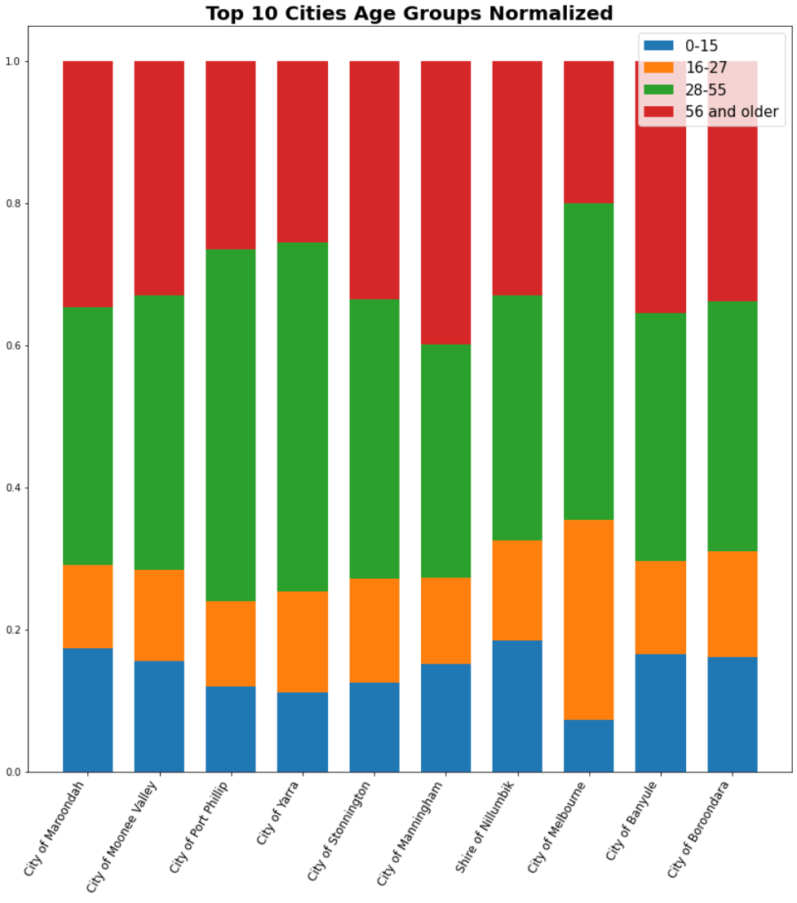
Age Groups
Age groups describe a city’s demographics:
  Larger blue segment indicates more young families in city.
  Larger orange indicates a large proportion of youths.
  Larger red indicates many retirees in the area.

